Slide 1
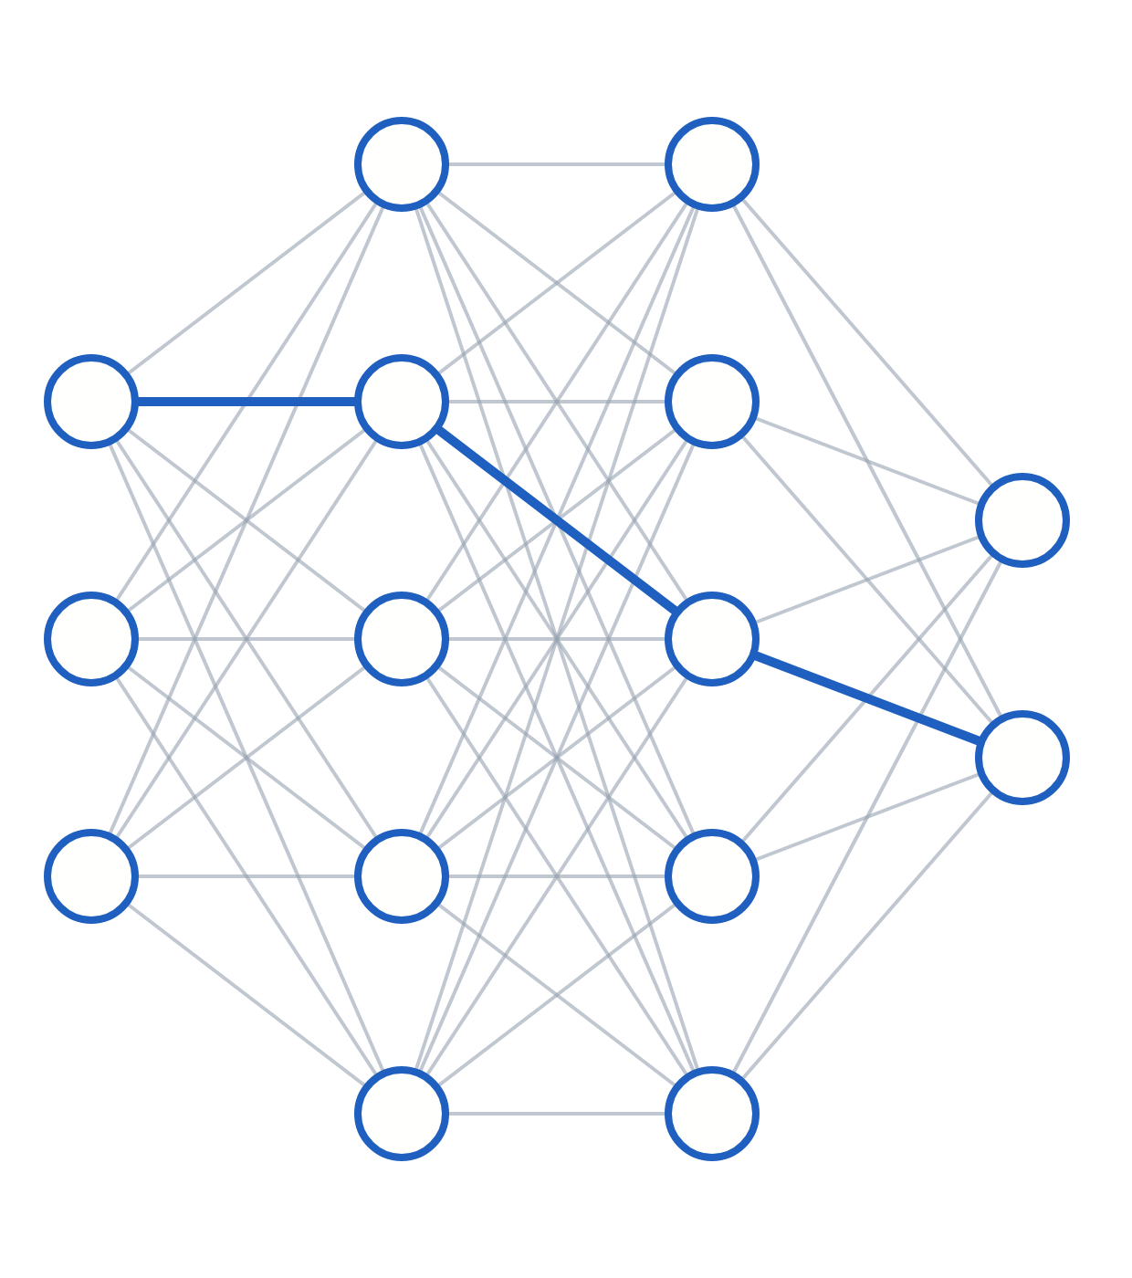
Learning: losses, backpropagation and gradient descent
LECTURE 2 OF 3 · SECTIONS 5–7
How a network measures its error, computes every gradient at once, and uses those gradients to improve.
Neural Networks & Deep Learning · Undergraduate engineering
Notes:
Welcome back. Last time we built the model: neurons, activations and the forward pass. Today we make it learn. Section 5 is how we measure error, and why the right loss follows from a probabilistic assumption. Section 6 is backpropagation, the efficient way to get every gradient. Section 7 is gradient descent: what to do with those gradients, how to pick a learning rate, and how to read the training curves.

Slide 2
By the end of this lecture you will be able to explain and derive these five ideas.
LEARNING OBJECTIVES
01
Derive MSE and cross-entropy as maximum-likelihood losses, and explain why MSE fails for classification.
02
Explain why raw logits must go into a fused loss, using the log-sum-exp trick.
03
State and justify the four backpropagation equations, and run them by hand on a small network.
04
Derive the softmax plus cross-entropy gradient, ŷ − y.
05
Choose a learning rate and batch size, and diagnose training from loss curves.
Lecture 2 · Learning: losses, backpropagation, gradient descent
02 / 31
Notes:
Five things you should be able to do by the end. Two are derivations you should be able to reproduce on a blank page: the maximum-likelihood origin of the losses, and the softmax-cross-entropy gradient. One is the four backpropagation equations, which are the core of the whole course. And two are practical judgement: picking a learning rate and batch size, and reading loss curves.

Slide 3
Today’s new symbols are the error signal δ, the logits z, and the learning rate η.
NOTATION
Symbol | Meaning
ŷ, y | Prediction, target (one-hot for classes)
z | Logits: raw scores before softmax
L, J | Loss per example, batch average
σ, softmax | Sigmoid, normalized exponential
θ | All parameters
η | Learning rate
Symbol | Meaning
δ[l] | ∂L/∂z[l], error signal at layer l
Δ[l] | Batched error, shape (m, n[l])
⊙ | Elementwise product
W[l]ᵀ | Transpose of layer l’s weights
m | Examples in a batch
λₘₐₓ | Largest Hessian eigenvalue
Lecture 2 · Learning: losses, backpropagation, gradient descent
03 / 31
Notes:
Today's notation, on top of Lecture 1's. y-hat is the prediction and y the target, one-hot for classification. z at the output layer are the logits, the raw scores before softmax. Theta collects all parameters and eta is the learning rate. Delta of l is the error signal, the derivative of the loss with respect to the pre-activation z of layer l, and capital Delta is its batched version with one row per example. The circle-dot is the elementwise product. Lambda-max is the largest eigenvalue of the Hessian, which will set the learning-rate limit.

Slide 4
A good loss is differentiable, matches the goal, and stays steep when the model is wrong.
§5 · LOSS FUNCTIONS
BATCH OBJECTIVE
Differentiable
J = (1/m) Σᵢ L(ŷ⁽ⁱ⁾, y⁽ⁱ⁾)
So gradients exist.
Averaging keeps the gradient scale independent of batch size, so changing m does not force re-tuning η.
Aligned with the goal
Lower loss should mean a better model.
Well-conditioned
Its gradient must stay large exactly when the model is badly wrong.
Lecture 2 · Learning: losses, backpropagation, gradient descent
04 / 31
Notes:
A loss function turns the prediction and the target disagree into a single number to minimize. For one example we write L of y-hat and y; over a batch we average to get J. We average rather than sum so that the gradient magnitude does not depend on batch size, which means you can change the batch size without re-tuning the learning rate from scratch. A good loss has three properties: it is differentiable, it is aligned with the real goal, and it is well-conditioned, meaning its gradients do not vanish precisely when the model is badly wrong. That last property is the one people forget, and it does most of the work in this section.

Slide 5
Minimizing mean squared error is maximum likelihood under Gaussian noise.
§5 · LOSS FUNCTIONS
MAXIMUM LIKELIHOOD WITH GAUSSIAN NOISE
The assumption is the limit. MSE is right only when the noise is roughly Gaussian.
y = f(x) + ε, ε ~ N(0, σ²)
log P = Σᵢ −(y⁽ⁱ⁾ − f(x⁽ⁱ⁾))² / 2σ² + const
max log P ⇔ min Σᵢ (y⁽ⁱ⁾ − f(x⁽ⁱ⁾))²
L = ½(ŷ − y)² ⇒ dL/dŷ = ŷ − y
Heavy tails? Use Huber loss. Count targets? Use a Poisson loss.
The ½ is cosmetic. PyTorch’s MSE omits it, and the factor is absorbed into η.
Lecture 2 · Learning: losses, backpropagation, gradient descent
05 / 31
Notes:
Mean squared error, for regression. Where does it come from? Assume the target is the model output plus Gaussian noise with variance sigma squared. Write the likelihood, take the log over m independent examples, and everything except the squared error is constant. Maximizing the log-likelihood means minimizing the sum of squared errors. MSE is maximum likelihood under Gaussian noise. That justification also tells you when MSE is the wrong choice. When the noise is heavy-tailed, use Huber loss, the next slide. When the target is a count, use a Poisson loss. The one-half is just a convenience that cancels when you differentiate. PyTorch omits it; the difference is absorbed into the learning rate.

Slide 6
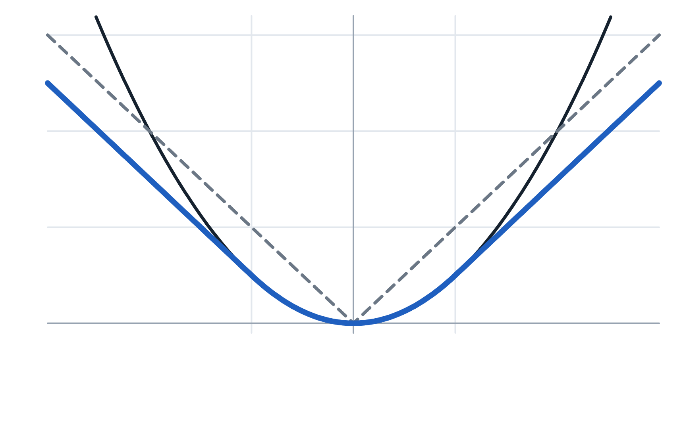
Huber loss is quadratic near zero and linear for outliers, so one bad point cannot dominate.
§5 · LOSS FUNCTIONS
HUBER LOSS, THRESHOLD Δ
½e²
L = ½ e² if |e| ≤ δ
L = δ(|e| − ½δ) otherwise
|e|
Huber
Quadratic near 0, so it converges cleanly.
linear far away, so one wild outlier cannot dominate the gradient. Standard in object detection.
−δ
0
δ = 1
error e = ŷ − y
Lecture 2 · Learning: losses, backpropagation, gradient descent
06 / 31
Notes:
Here are the three regression losses side by side, as functions of the error. Squared error grows quadratically, so it penalizes large errors heavily, which is exactly what you want under Gaussian noise and exactly what you do not want with outliers. Absolute error grows linearly; its gradient has constant magnitude, so it is robust to outliers but has a kink at zero. Huber loss takes the best of both. Inside a threshold delta it is one half e squared; outside it is delta times the absolute error minus one half delta, which makes the two pieces meet smoothly. Quadratic near the minimum, so it converges cleanly; linear far away, so a single wild outlier cannot dominate the gradient. PyTorch calls it smooth L1, and it is standard in object detection.

Slide 7
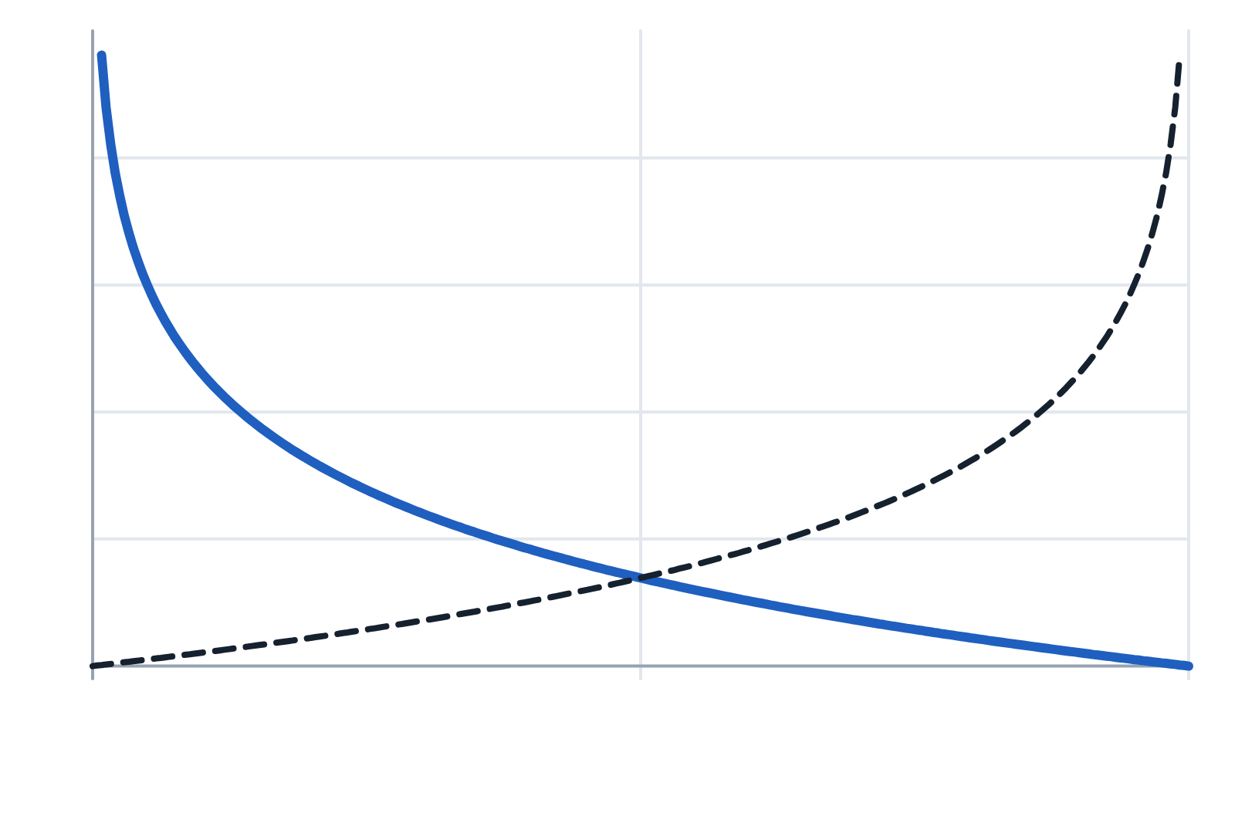
Binary cross-entropy is minus the log of the probability assigned to the correct class.
§5 · LOSS FUNCTIONS
ONE TERM SURVIVES
4
y = 1: −log ŷ
y = 0: −log(1 − ŷ)
L = −[y log ŷ + (1 − y) log(1 − ŷ)]
BERNOULLI LIKELIHOOD
2
P(y | x) = ŷʸ (1 − ŷ)¹⁻ʸ
−log P(y | x) = L
Confidently wrong costs without limit, and gives the biggest gradient when it is most needed.
0
0.5
1
predicted probability ŷ = σ(z)
Lecture 2 · Learning: losses, backpropagation, gradient descent
07 / 31
Notes:
For two-class problems the model outputs y-hat equals sigma of z, read as the probability that y equals one. Binary cross-entropy looks intimidating, but read it as a switch: because y is zero or one, exactly one term survives. If y is one, the loss is minus log y-hat; if y is zero, it is minus log of one minus y-hat. So the loss is minus the log of the probability assigned to the correct class. On the plot, the solid curve goes to zero as the prediction approaches one and to infinity as it approaches zero. Confidently wrong is punished without limit, and that unbounded penalty is a feature: it produces a huge gradient exactly when the model needs correcting most. Where it comes from: each label is a Bernoulli draw with parameter y-hat. Take the log and negate, and you get BCE. Binary cross-entropy is maximum likelihood under a Bernoulli model.

Slide 8
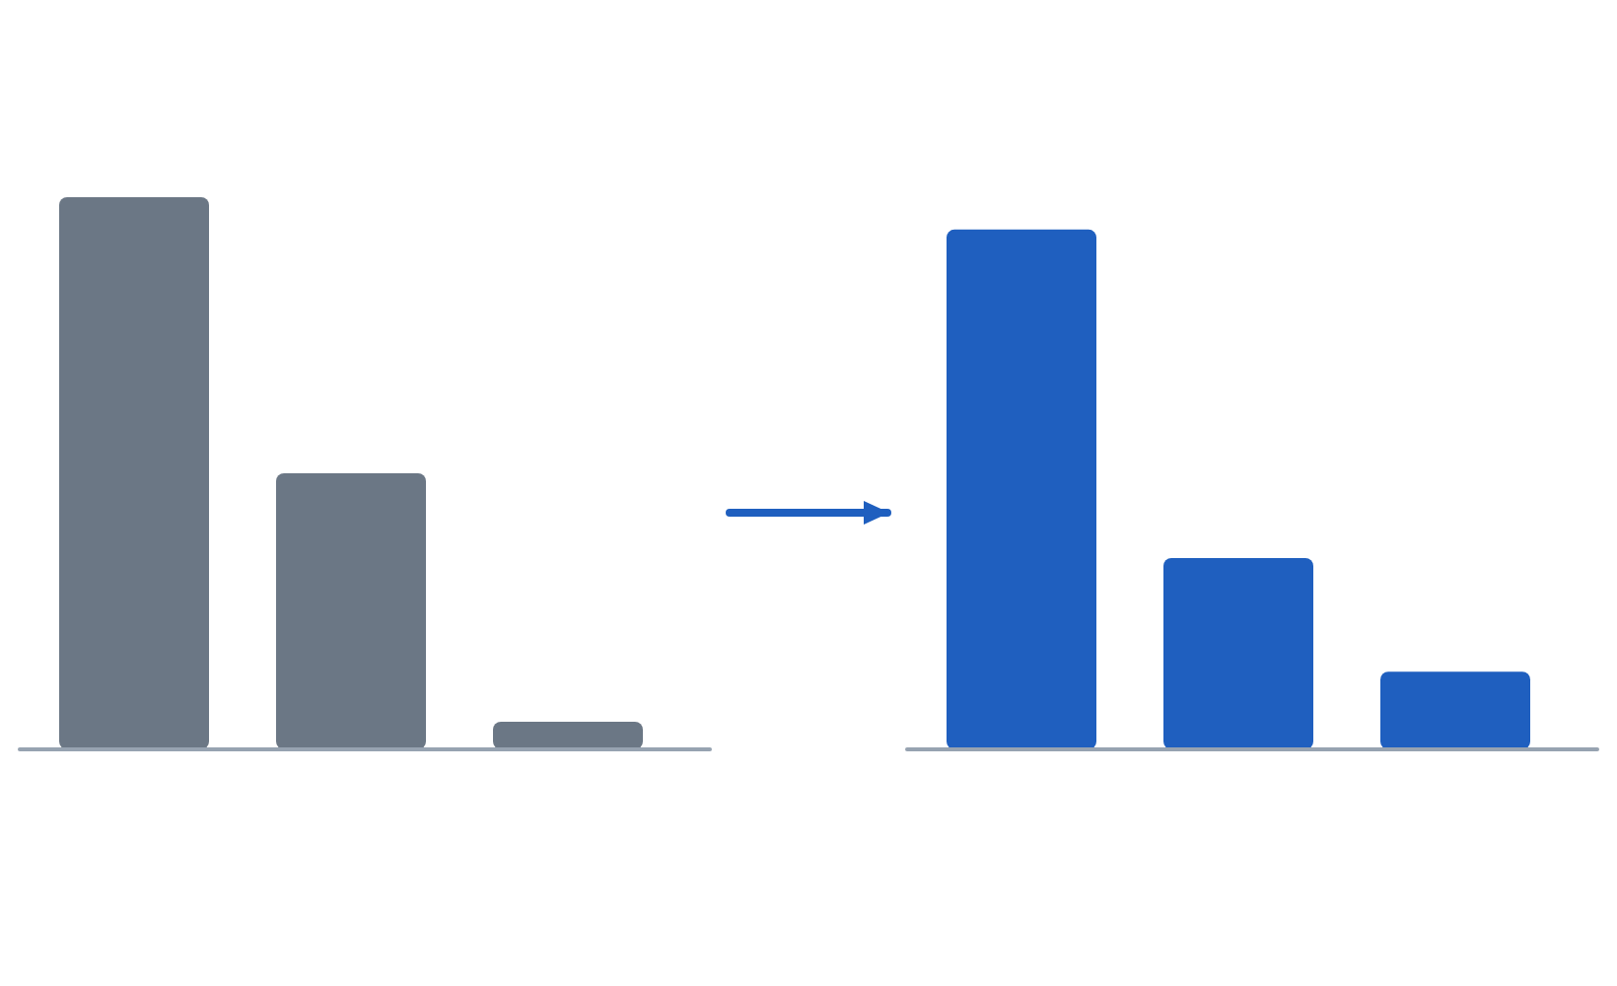
Softmax turns K logits into a probability distribution over the classes.
§5 · LOSS FUNCTIONS
SOFTMAX AND CATEGORICAL CROSS-ENTROPY
2.0
0.659
ŷₖ = exp(zₖ) / Σⱼ exp(zⱼ)
L = −Σₖ yₖ log ŷₖ
= −log ŷₖ (k = true class)
1.0
softmax
0.242
Shift-invariant. softmax(z + c) = softmax(z) for any constant c.
0.099
0.1
z₁
z₂
z₃
ŷ₁
ŷ₂
ŷ₃
Temperature. softmax(z/T) flattens for T > 1 and sharpens for T < 1.
logits z
probabilities, sum = 1
Lecture 2 · Learning: losses, backpropagation, gradient descent
08 / 31
Notes:
For K classes, the output layer produces K raw scores called logits. Softmax exponentiates and normalizes them, so every output is positive and they sum to one. Here logits of 2, 1 and 0.1 become probabilities of about 0.66, 0.24 and 0.10. With one-hot targets, categorical cross-entropy collapses to minus the log probability of the true class. If the model gives the true class 0.9, the loss is 0.105; at 0.5 it is 0.693; at 0.01 it is 4.6. Two properties worth knowing. Shift invariance: adding a constant to every logit changes nothing, because the e to the c factors cancel. That is what makes the numerically stable implementation valid. And temperature: dividing logits by T greater than one flattens the distribution, less than one sharpens it, and as T goes to zero it approaches a one-hot argmax.

Slide 9
A randomly initialized K-class model should start at a loss of about ln K.
§5 · THE CHEAPEST BUG DETECTOR IN DEEP LEARNING
For 10 classes that is ln 10 ≈ 2.303. A first loss far from ln K means something is wrong before training begins: the labels, the output size, or an extra softmax.
Lecture 2 · Learning: losses, backpropagation, gradient descent
09 / 31
Notes:
Here is the sanity check to memorize. A randomly initialized classifier should give roughly uniform probabilities, one over K for each class. Minus the log of one over K is the log of K. For ten classes that is 2.303; for a hundred classes, about 4.6. If your very first loss is 15, something is wrong before training even begins: the labels, the output size, or an accidental extra softmax. And if a hundred-class model starts at 2.3, suspect a ten-unit output head, since log of ten is 2.3. Check the output shape first. It takes one print statement, and it catches a surprising number of bugs.

Slide 10
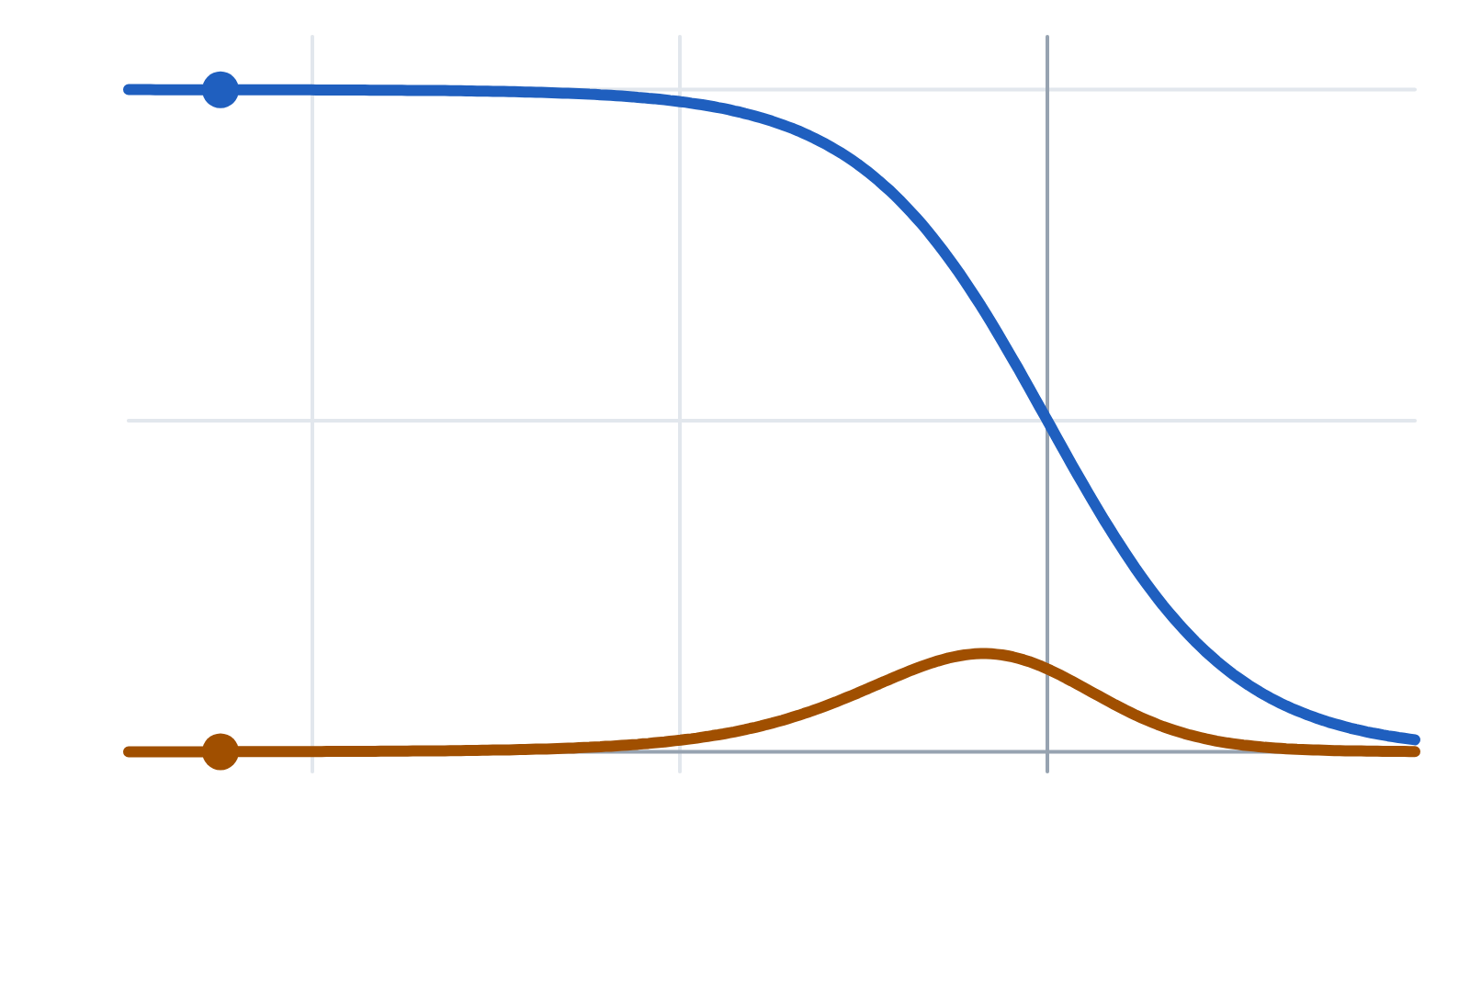
Cross-entropy keeps a full gradient when the model is confidently wrong, and MSE does not.
§5 · LOSS FUNCTIONS
1
MSE WITH A SIGMOID
cross-entropy: |ŷ − y| ≈ 1
dL/dz = (σ(z) − y)·σ(z)(1 − σ(z))
z ≈ −9: ≈ (−1)(0.0001)
CROSS-ENTROPY WITH A SIGMOID
dL/dz = σ(z) − y = ŷ − y
MSE ≈ 0.0001: stalled
MSE is also the wrong likelihood for labels, and is non-convex even for one sigmoid neuron.
−8
−4
0
logit z (true label y = 1)
|∂L/∂z| for a model that is wrong
Lecture 2 · Learning: losses, backpropagation, gradient descent
10 / 31
Notes:
Why not MSE for classification? There are three reasons, and the gradient argument is the one interviewers want. Take binary classification with a sigmoid output and MSE. Differentiate with respect to the logit and you get the error times sigma times one minus sigma. Now suppose the truth is one but the model predicts 0.0001, so z is about minus nine. The error is nearly minus one, good, but the sigmoid derivative is about 0.0001, so the gradient is almost zero. The model is as wrong as it can be, and learning stalls. That is the MSE curve collapsing on the left. Now cross-entropy. The sigmoid derivative cancels against the derivative of the log, and the gradient is exactly y-hat minus y, the prediction error. Confidently wrong means a full-strength gradient; right means near zero. That is the cross-entropy curve. The other two reasons: MSE is the wrong likelihood for class labels, and MSE composed with a sigmoid is non-convex even for one neuron, while cross-entropy with a sigmoid is convex.

Slide 11
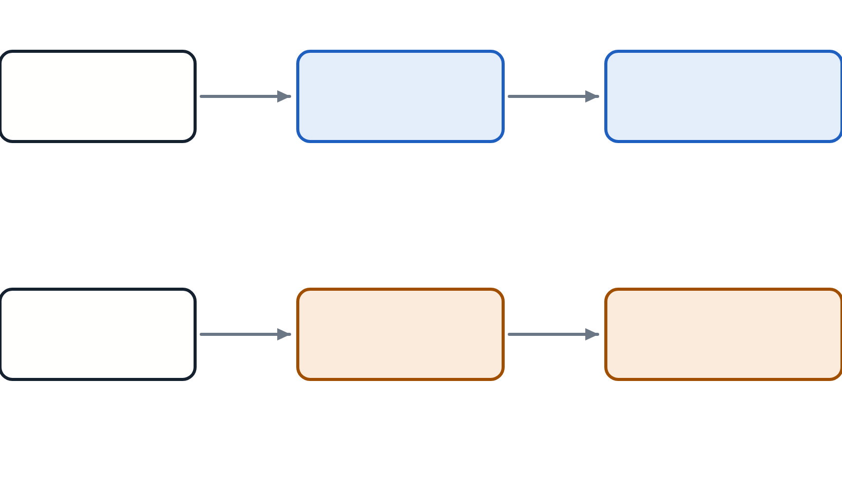
Pass raw logits to a fused loss, which stays numerically stable through log-sum-exp.
§5 · LOSS FUNCTIONS
Do this
LOG-SUM-EXP TRICK
Model
Raw logits
CE loss
exp(1000) → inf ⇒ softmax → nan
c = maxⱼ zⱼ
log softmax(z)ₖ = zₖ − c − log Σⱼ exp(zⱼ − c)
log-softmax is applied once, inside the loss
Not this
No overflow. Every exponent zⱼ − c ≤ 0.
Model
Softmax
CE loss
No underflow. One term equals 1, so the sum is ≥ 1.
softmax applied twice: no error, damped gradients, low accuracy
Lecture 2 · Learning: losses, backpropagation, gradient descent
11 / 31
Notes:
Here is a rule to follow without exception in PyTorch: do not put a sigmoid or softmax at the end of your model. Pass raw logits to BCEWithLogitsLoss or CrossEntropyLoss. The reason is floating point. A logit of a thousand makes e to the thousand overflow to infinity in float32, softmax returns not-a-number, and your loss is nan forever. Or a probability underflows to zero and the log goes to minus infinity. The fused losses use the log-sum-exp trick. Because softmax is shift-invariant, subtract the maximum logit, called c here, before exponentiating. Every exponent is then at most zero, so nothing overflows, and at least one term equals exactly one, so the sum cannot underflow. Mathematically identical, numerically safe. And the bottom pipeline is one of the most common, hardest-to-spot beginner bugs: CrossEntropyLoss already includes log-softmax, so applying softmax yourself applies it twice. Nothing errors; the model just trains poorly.

Slide 12
Match the loss to the task, and give it raw logits with correctly formatted targets.
§5 · LOSS FUNCTIONS
Task | PyTorch loss | Model output | Target
Regression | MSELoss | (m, 1) raw | (m, 1) float
Robust regression | SmoothL1Loss | (m, 1) raw | (m, 1) float
Binary | BCEWithLogitsLoss | (m, 1) logits | (m, 1) float 0/1
Multi-class | CrossEntropyLoss | (m, K) logits | (m,) integer class indices
Multi-label | BCEWithLogitsLoss | (m, K) logits | (m, K) float 0/1
LABEL SMOOTHING, PYTORCH CONVENTION
Passing softmax outputs instead of logits raises no error and quietly degrades the model.
target = (1 − ε) · one-hot + ε / K ε ≈ 0.1
Lecture 2 · Learning: losses, backpropagation, gradient descent
12 / 31
Notes:
This is the table you will reference constantly. Regression uses MSELoss on raw outputs, or SmoothL1Loss, PyTorch's Huber, when you need robustness. Binary classification uses BCEWithLogitsLoss on logits with float targets of zero or one. Multi-class single-label uses CrossEntropyLoss on an m by K logit matrix with a vector of integer class indices, not one-hot. Multi-label uses BCEWithLogitsLoss with one sigmoid per class. Two errors account for most CrossEntropyLoss failures. Passing one-hot targets at least raises a dtype error. Passing softmax outputs instead of logits raises nothing and quietly degrades your model. Two useful options. Label smoothing replaces the one-hot target with one minus epsilon times the one-hot vector plus epsilon over K spread uniformly, typically epsilon 0.1. That is the convention PyTorch implements; some texts spread epsilon over K minus one classes instead. It which discourages overconfidence and improves calibration; it is standard in modern image classification. And class weights let you weight rare classes up when the data are imbalanced.

Slide 13
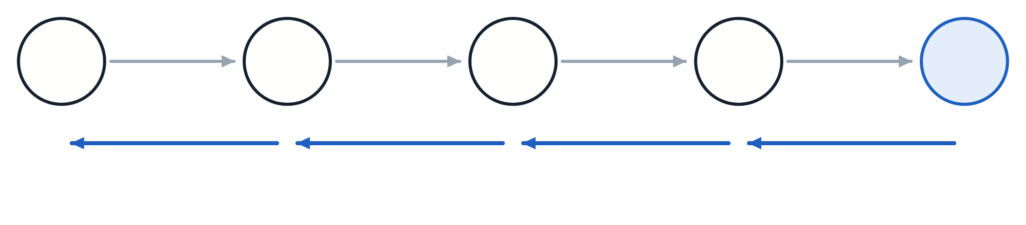
Backpropagation computes every gradient for roughly the cost of one extra forward pass.
§6 · BACKPROPAGATION
Backpropagation is the chain rule applied to a computational graph, organized so shared work is done once.
FINITE DIFFERENCES
10⁸
x
a
b
c
J
forward passes per step for 10⁸ parameters: over a day
∂a/∂x
∂b/∂a
∂c/∂b
∂J/∂c
BACKPROPAGATION
≈ 1
dy/dx = Σᵢ (∂y/∂uᵢ)(duᵢ/dx) paths add
extra pass for every gradient at once
Lecture 2 · Learning: losses, backpropagation, gradient descent
13 / 31
Notes:
This is the section to slow down for. Backpropagation is how a network learns, it is the most-asked topic in deep learning interviews, and it is the one thing in this course people routinely pretend to understand. The headline is on the slide: it is the chain rule applied to a computational graph, organized so that shared subexpressions are computed once. And keep the distinction clean from the start: backprop computes gradients; gradient descent, or Adam, or anything else, decides what to do with them. The problem: a loss that depends on millions of parameters, and gradient descent needs the partial derivative for every one. The naive approach is finite differences: nudge each parameter and watch the loss. It works, and it is a useful debugging tool, but each parameter needs its own forward pass. A hundred-million-parameter model needs a hundred million passes per step, over a day at a millisecond each. Backpropagation gets all the gradients for roughly the cost of one extra pass. That factor of a hundred million is the reason deep learning exists. The insight is in the chain. To get dJ by dx you need a product of four local derivatives; to get dJ by da you need the first three of them. Compute from the output backward and every new gradient reuses the product you already have. That is reverse-mode automatic differentiation. And when a variable affects the output through several paths, its gradient is the sum over paths. Why reverse and not forward? One output, millions of inputs. Reverse mode costs a sweep per output, forward mode a sweep per input.

Slide 14
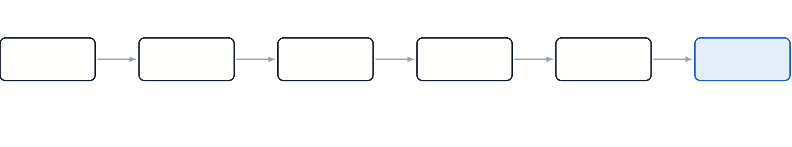
Walking a one-unit network backward shows the error signal shrinking 6.7× in one layer.
§6 · BACKPROPAGATION
forward →
1.1
0.7503
0.3002
0.5745
0.0905
x = 2.0
z₁
a₁
z₂
a₂
L
← backward
δ₁ = −0.0156
∂L/∂a₁ = −0.0832
δ₂ = −0.1040
∂L/∂a₂ = −0.4255
w₁ = 0.5, b₁ = 0.1
w₂ = 0.8, b₂ = −0.3
L = ½(a₂ − y)², y = 1
∂L/∂w₂ = δ₂ · a₁ = −0.0780
∂L/∂b₂ = δ₂ = −0.1040
∂L/∂w₁ = δ₁ · x = −0.0312
∂L/∂b₁ = δ₁ = −0.0156
Pattern. Weight gradient = error at its output × activation at its input. Bias gradient = the error itself.
δ shrank 6.7× in one layer because σ′ ≤ 0.25.
Lecture 2 · Learning: losses, backpropagation, gradient descent
14 / 31
Notes:
Before the general derivation, one concrete case with a pencil. One input, one sigmoid hidden unit, one sigmoid output, squared error. Weights 0.5 and 0.8, biases 0.1 and minus 0.3, input 2, target 1. Forward, the top row: z1 is 1.1, a1 is 0.7503, z2 is 0.3002, a2 is 0.5745, and the loss is 0.0905. Backward, the bottom row, revealed one click at a time, local derivative times what came from the right. dL by da2 is a2 minus y, minus 0.4255. Multiply by a2 times one minus a2 to get delta two, minus 0.104. Multiply by w2 to get dL by da1, minus 0.0832. Multiply by the sigmoid derivative at z1 to get delta one, minus 0.0156. Now read the pattern off the arithmetic. A weight's gradient is the error signal at its output times the activation at its input. A bias's gradient is just the error signal. The error propagates backward by multiplying by the weight and then the activation derivative. And it shrinks: from minus 0.104 to minus 0.0156, a factor of 6.7 in one layer. Twenty layers of that and nothing reaches the front. You have just watched the vanishing gradient problem happen.

Slide 15
Four equations, BP1 to BP4, are the whole of backpropagation.
§6 · BACKPROPAGATION
The error signal δ[l] = ∂L/∂z[l] is defined on the pre-activation, so weight gradients fall out directly.
BP1 · OUTPUT ERROR
BP2 · PROPAGATE BACK
δ[L] = ∇ₐL ⊙ g′(z[L])
δ[l] = (W[l+1]ᵀ δ[l+1]) ⊙ g′(z[l])
Softmax with cross-entropy: δ[L] = a[L] − y.
Send error back through Wᵀ, gated by g′.
BP3 · BIAS GRADIENT
BP4 · WEIGHT GRADIENT
∂L/∂b[l] = δ[l]
∂L/∂W[l] = δ[l] a[l−1]ᵀ
Because ∂z[l]/∂b[l] = 1.
Outer product, shape (n[l], n[l−1]).
Lecture 2 · Learning: losses, backpropagation, gradient descent
15 / 31
Notes:
Now the general case. Define the error signal delta at layer l as the derivative of the loss with respect to the pre-activation z. We define it on z rather than on a because it makes the weight gradients fall out immediately. BP1, the error at the output: the gradient of the loss with respect to the activation, elementwise times g prime. Elementwise because g acts elementwise, so there is no sum. For softmax with cross-entropy it collapses to a minus y. BP2, propagate backward: delta at layer l is W of the next layer transposed times the next delta, gated elementwise by g prime. It comes from the multivariable chain rule, because z at layer l affects the loss only through every unit of the next layer. BP3: the bias gradient is just delta. BP4: the weight gradient is the outer product of delta with the previous activation. If you can reproduce these four lines and say why each is true, you understand backpropagation. Cover the page and try.

Slide 16
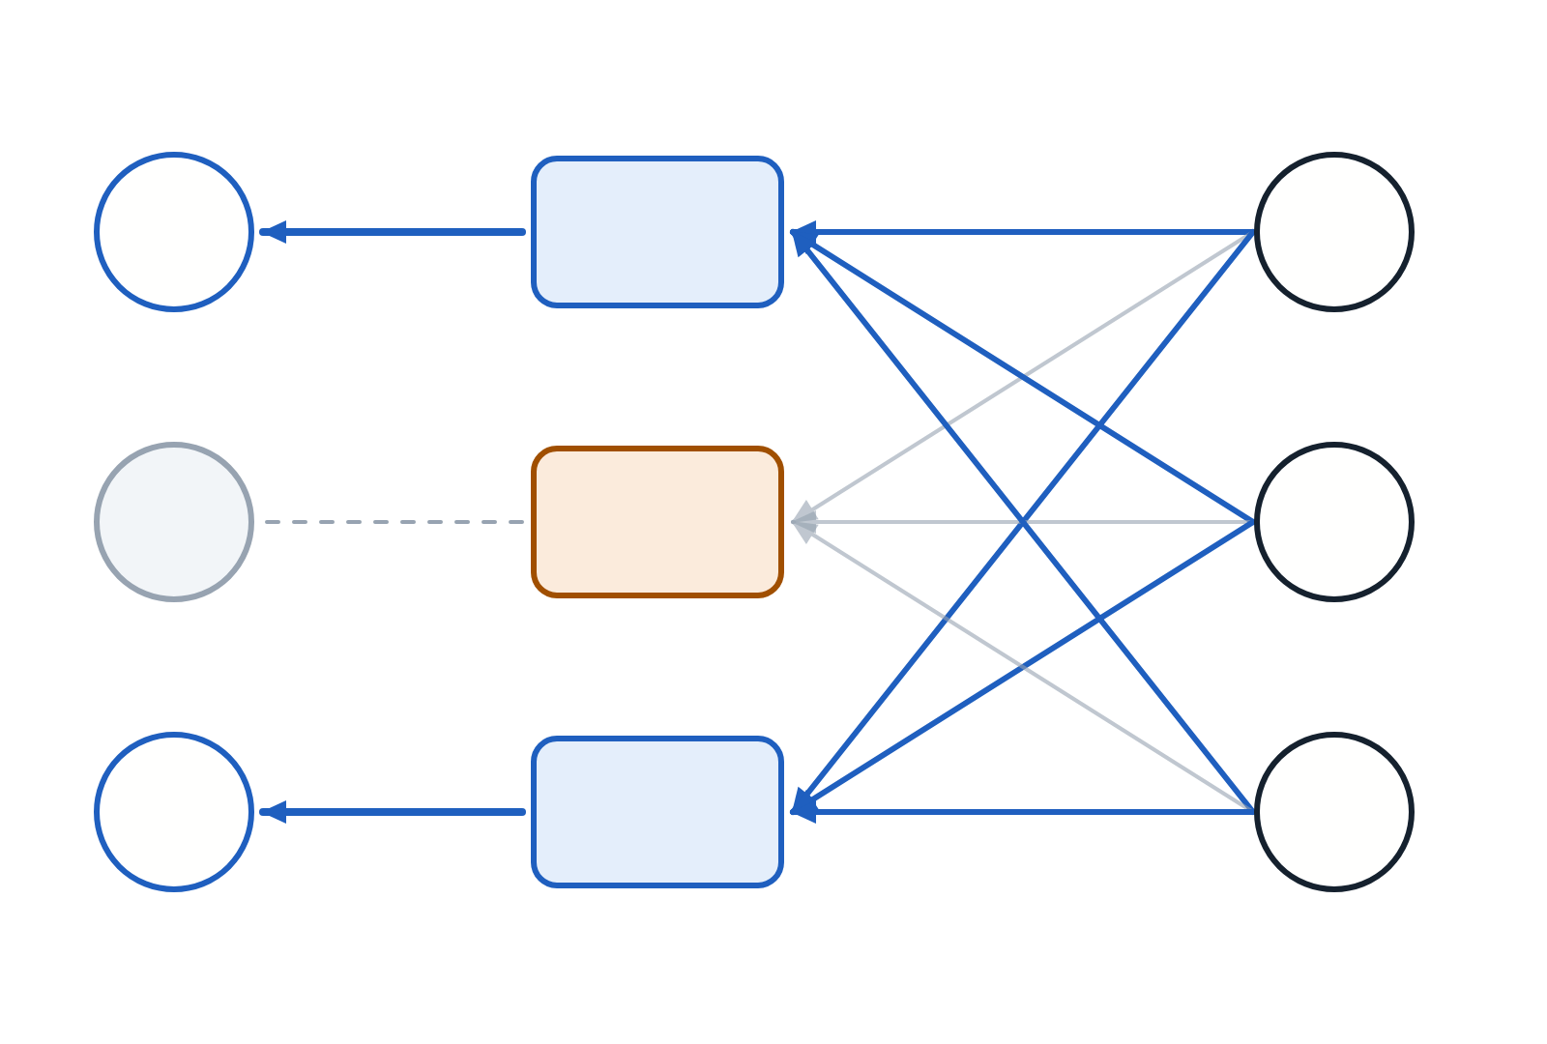
A saturated unit blocks the error, and an inactive input leaves its weight almost unchanged.
§6 · BACKPROPAGATION
δ[l]
W[l+1]ᵀ
δ[l+1]
Why the transpose. Forward maps n[l] → n[l+1], so sending error back needs Wᵀ.
⊙ g′
Why the gate. A saturated unit has g′ ≈ 0 and blocks the error.
g′ = 0.9
BP4 by entry. ∂L/∂W[l]ⱼᵢ = δ[l]ⱼ · a[l−1]ᵢ, so inactive inputs barely move their weights.
⊙ g′
g′ ≈ 0.02
⊙ g′
g′ = 0.7
saturated unit: its error is blocked
Lecture 2 · Learning: losses, backpropagation, gradient descent
16 / 31
Notes:
Let us read BP2 and BP4 as engineering statements. In BP2, the transpose of W sends the error backward through the same connections. It has to be the transpose, because the forward pass maps layer l to layer l plus one, and the backward pass maps an error of size n of l plus one to one of size n of l. Shape-checking alone forces it. Then the elementwise product with g prime gates the error by how responsive each unit was. The middle unit here is saturated, its derivative is about 0.02, and its error is essentially blocked. BP4 says each weight's gradient is the error at its output times the activation at its input. So if an input activation is small, that weight barely learns: units that do not activate do not learn. That is why input standardization matters and why dead ReLUs are dead. And if delta is small, because the unit saturated or the error already vanished on the way back, that entire row of the weight matrix barely learns.

Slide 17
In batched code, one matrix product sums every example’s gradient automatically.
§6 · BACKPROPAGATION
SHAPE CHECK
ROW CONVENTION, BATCH OF M
(n[l], m) × (m, n[l−1])
= (n[l], n[l−1]) ✓
Δ[L] = (A[L] − Y) / m softmax + CE
Δ[l] = (Δ[l+1] W[l+1]) ⊙ g′(Z[l])
∂J/∂W[l] = Δ[l]ᵀ A[l−1]
∂J/∂b[l] = Δ[l] summed over examples
Only one arrangement produces the parameter’s shape. Use that to place every transpose.
Lecture 2 · Learning: losses, backpropagation, gradient descent
17 / 31
Notes:
Here is what code actually does, with m examples in rows. The output error is A minus Y divided by m for softmax with cross-entropy. The backward step multiplies by W instead of W transpose, because examples are now rows. The weight gradient is delta transposed times the previous activations, and the bias gradient is delta summed over the batch dimension. Two things changed. The transpose moved. And the outer product became a matrix product, which sums over the batch automatically: each example contributes its own outer product and they add. The bias has to be summed explicitly because it was broadcast across all m rows. Whenever you are unsure whether a transpose belongs, check which arrangement produces the shape of the parameter. There is usually only one.

Slide 18

A training step costs about three forward passes, and stored activations dominate memory.
§6 · BACKPROPAGATION
Forward
Input gradient
Weight gradient
1 unit
1 unit
1 unit
Stored activations. BP4 needs a[l−1], so every layer’s activations wait in memory for the backward pass.
one training step ≈ 3 × one inference step
each unit = one matrix product, O(m · n[l] · n[l−1])
Out of memory? Reduce the batch size first.
Checkpointing. Store some activations, recompute the rest: about 30% more compute.
Lecture 2 · Learning: losses, backpropagation, gradient descent
18 / 31
Notes:
Two engineering consequences of the batched equations. Cost: for every layer, the forward pass does one matrix product, and the backward pass does two, one for the gradient with respect to the input and one for the gradient with respect to the weights. So a training step costs roughly three times an inference step. That is the number to use when estimating training time. Memory is the other half. BP4 needs the previous layer's activation, so every layer's activations must be kept from the forward pass until the backward pass reaches them. That is why memory scales with batch size, why an out-of-memory error in the backward pass is fixed by reducing batch size, and why turning off gradient tracking at inference saves so much memory. If you are memory-bound, gradient checkpointing stores only some activations and recomputes the rest during the backward pass, trading about thirty percent more compute for large memory savings.

Slide 19
The softmax plus cross-entropy gradient collapses to prediction minus target.
§6 · BACKPROPAGATION
Quotient rule, then the chain rule through L = −Σₖ yₖ log ŷₖ:
S = Σⱼ exp(zⱼ), ŷₖ = exp(zₖ) / S
RESULT
k = i: ∂ŷₖ/∂zₖ = ŷₖ (1 − ŷₖ)
∂L/∂z = ŷ − y
k ≠ i: ∂ŷₖ/∂zᵢ = −ŷₖ ŷᵢ
The softmax Jacobian cancels against the log. Frameworks fuse the two, so the backward pass is a subtraction.
both: ∂ŷₖ/∂zᵢ = ŷₖ ([k = i] − ŷᵢ)
∂L/∂zᵢ = Σₖ (−yₖ/ŷₖ) · ŷₖ ([k = i] − ŷᵢ)
= −yᵢ + ŷᵢ Σₖ yₖ = ŷᵢ − yᵢ
[k = i] is 1 if k = i, else 0. One-hot y gives Σₖ yₖ = 1.
Lecture 2 · Learning: losses, backpropagation, gradient descent
19 / 31
Notes:
This derivation appears in interviews constantly, so do it by hand once. Step one, the derivative of softmax, which has two cases. Write S for the sum of exponentials. When k equals i, the quotient rule gives y-hat-k times one minus y-hat-k. When k differs from i, only S depends on z-i, giving minus y-hat-k times y-hat-i. Combine them with an indicator: y-hat-k times the indicator minus y-hat-i. Step two, chain through the loss. The derivative of minus y-k log y-hat-k with respect to y-hat-k is minus y-k over y-hat-k. Multiply, and the y-hat-k cancels. Sum over k and you get minus y-i plus y-hat-i times the sum of the targets, which is one for a one-hot vector. The result: prediction minus target. No exponentials, no division, no activation derivative. The messy softmax derivative cancels exactly against the log. That is why frameworks fuse the two into one operation. Reveal each line in turn and ask the room for the next step before clicking.

Slide 20

Check a hand-derived gradient with a centred difference and a relative-error threshold.
§6 · BACKPROPAGATION
CENTRED DIFFERENCE, ERROR O(Ε²)
∂J/∂w ≈ [J(w + ε) − J(w − ε)] / 2ε
rel = |a − n| / max(|a|, |n|, 10⁻⁸)
Use float64. Single-precision rounding swamps the signal.
Make it deterministic. Turn off dropout and other randomness.
relative error, log scale
correct
suspicious
bug
Sample parameters. Each one costs two forward passes.
1e-10
1e-7
1e-4
1e-1
1e-3
Lecture 2 · Learning: losses, backpropagation, gradient descent
20 / 31
Notes:
If you implement a gradient by hand, verify it numerically. Use the centred difference, J of w plus epsilon minus J of w minus epsilon over two epsilon, whose error is order epsilon squared rather than order epsilon. Then compare analytic and numeric with a relative error. Rules of thumb on the scale: below ten to the minus seven is correct; between that and ten to the minus four is suspicious and worth investigating; above ten to the minus three means you have a bug. Three practical notes. Use float64, or rounding noise drowns the comparison. Turn off dropout and anything stochastic, since the loss must be deterministic. And check a random subset of parameters, because the procedure costs two forward passes per parameter. The tutorial's from-scratch implementation is the payoff: a two-layer NumPy network with no autograd, every line mapped to one of BP1 to BP4, trained on XOR. Run it and the loss falls from about 0.69, which is log two, the two-class random baseline, to near zero.

Slide 21
Backpropagation computes gradients, and the optimizer decides what to do with them.
§6 · BACKPROPAGATION
Is backprop gradient descent?
Why clear gradients each step?
No. Backprop computes gradients. An optimizer such as SGD or Adam decides how to use them.
PyTorch adds new gradients to old ones. That is deliberate: it lets you simulate large batches.
Why store activations?
Does it find the global minimum?
BP4 needs a[l−1]. The alternative is recomputing it, which is what checkpointing does.
No. But most critical points are saddles, and reachable minima have similar loss (§7).
Lecture 2 · Learning: losses, backpropagation, gradient descent
21 / 31
Notes:
Four confusions, resolved. Is backpropagation the same as gradient descent? No. Backprop computes gradients; gradient descent uses them. You could compute gradients by backprop and then update with Adam, with a genetic algorithm, or not at all. Why do we need zero_grad? PyTorch accumulates gradients rather than overwriting them. Skip it and step k uses the sum of all previous gradients, which grows without bound. The accumulation is deliberate: it lets you simulate a large batch on small hardware. Why store activations at all? BP4 needs them. The alternative is recomputing the forward pass, which is exactly what gradient checkpointing chooses to do. Does backprop find the global minimum? No, and neither does gradient descent. But in high dimensions most critical points are saddles rather than bad local minima, and the minima we reach tend to have similar loss. That is the next section.

Slide 22
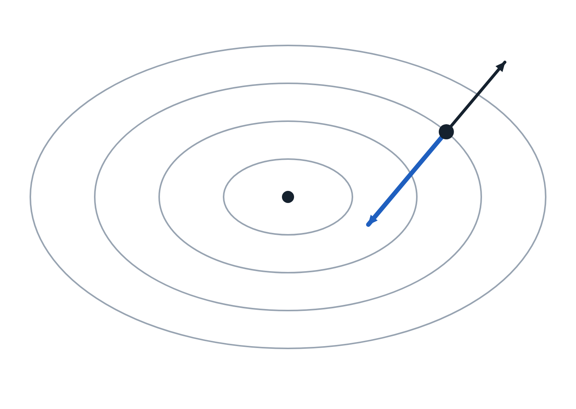
The negative gradient is the steepest-descent direction, but only for small steps.
§7 · GRADIENT DESCENT
∇J, uphill
FIRST-ORDER TAYLOR ARGUMENT
J(θ + Δθ) ≈ J(θ) + ∇J(θ)ᵀ Δθ
∇Jᵀ Δθ = ‖∇J‖ ‖Δθ‖ cos α
most negative at α = π: Δθ = −η ∇J
minimum
Only for small steps. The expansion is local. Too large a step is what divergence looks like.
−η∇J
Only in the Euclidean norm. Other norms give other update rules, one way to read Adam.
contours of J(θ); the gradient is perpendicular to them
Lecture 2 · Learning: losses, backpropagation, gradient descent
22 / 31
Notes:
Backpropagation hands you the gradient for every parameter. Gradient descent decides what to do with it: move each parameter a little way in the direction that reduces the loss. The gradient points uphill, steepest increase, so we subtract it. Why is that the steepest direction? Expand the loss to first order around the current parameters. For a step of fixed length, the change is the gradient dotted with the step, which is the product of their norms times the cosine of the angle between them. It is most negative when the cosine is minus one, when the step points exactly opposite the gradient. Two cautions follow straight from the derivation. It is only valid for small steps, because the Taylor expansion is local; take too big a step and the approximation is worthless, which is exactly what divergence looks like. And it is steepest only with respect to the Euclidean norm; other norms give other update rules, which is one way to understand what Adam is doing.

Slide 23
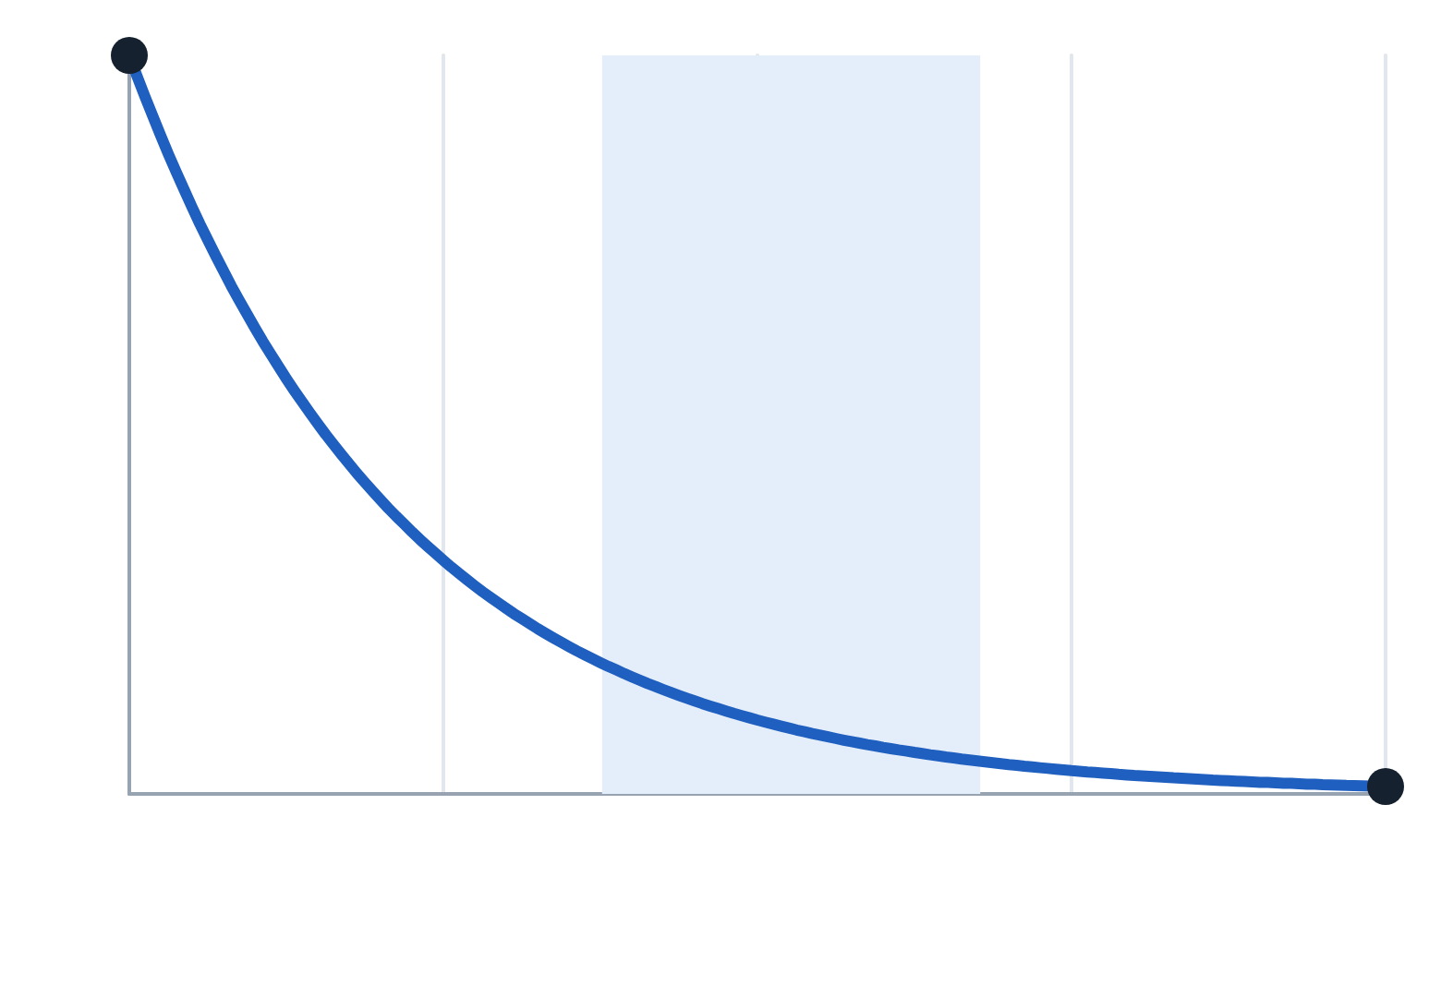
Mini-batches balance noise against cost, because noise falls only as 1/√m.
§7 · GRADIENT DESCENT
m = 1
 | Full batch | Mini-batch | SGD (m=1)
Gradient | exact | good estimate | noisy
Steps per epoch | 1 | N/m | N
Hardware use | good | excellent | poor
Verdict | too slow | use this | too noisy
mini-batch 32–512
full batch
One epoch is one pass over the data. One iteration is one update.
1
10
100
10³
10⁴
batch size m (log scale)
gradient noise ∝ 1/√m
Lecture 2 · Learning: losses, backpropagation, gradient descent
23 / 31
Notes:
How much data do you use to estimate the gradient at each step? Full-batch gradient descent uses all N examples: exact and smooth, but each step needs a full pass, so with a million examples one update takes minutes. Stochastic gradient descent uses one example: very fast, and the noise can help escape sharp regions, but the estimate is high-variance and single-example computation wastes hardware built for parallel arithmetic. Mini-batch uses 32 to 512 examples, and it is what everyone actually does; confusingly, it is what people mean today when they say SGD. The reason it wins is statistical, and it is the curve on the left. The standard error of a mean falls as one over root m. Going from one to a hundred cuts noise by ten; going from a hundred to ten thousand cuts it by another ten but costs a hundred times more compute. Diminishing returns in accuracy, linear growth in cost. And the free interview marks: an epoch is one pass over the data, an iteration is one update. Fifty thousand examples at batch size one hundred is five hundred iterations per epoch.

Slide 24
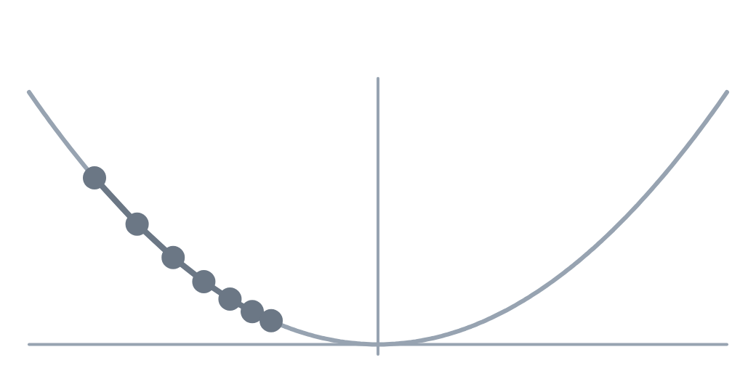
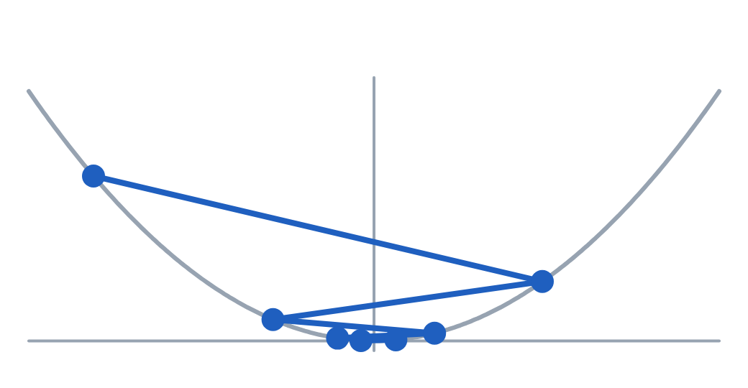
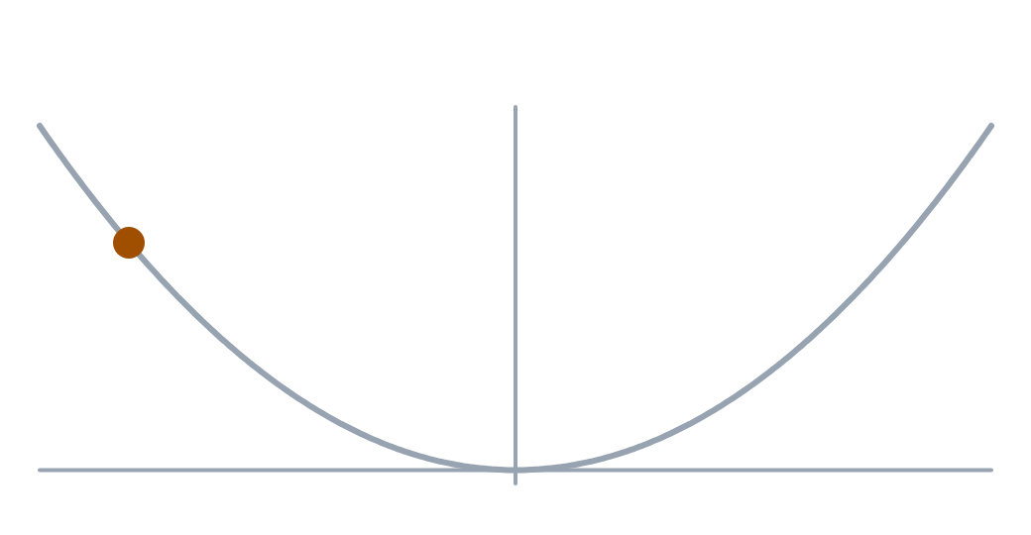
The sharpest curvature sets the learning-rate limit: η must stay below 2/λₘₐₓ.
§7 · GRADIENT DESCENT
η too small
η < 2/λ
η > 2/λ
θ ← 0.85 θ
θ ← −0.6 θ
θ ← −1.25 θ
J = ½λθ² ⇒ θ ← (1 − ηλ) θ
converges only if |1 − ηλ| < 1, i.e. η < 2/λ
In a network λ is the largest Hessian eigenvalue, so the sharpest direction sets the limit for all.
Lecture 2 · Learning: losses, backpropagation, gradient descent
24 / 31
Notes:
The learning rate is the most important hyperparameter in deep learning. Not among the most important; the most important. The table gives the symptoms: far too large and the loss is nan within a few steps; too large and it oscillates or plateaus high; good and it falls steadily then flattens; too small and it creeps. Why does a large rate diverge? Take a quadratic bowl, J equals one half lambda theta squared. The update multiplies theta by one minus eta lambda each step, so it converges only if that factor has magnitude below one: eta less than two over lambda. The three panels show a factor of 0.85, slow; minus 0.6, oscillating but converging; and minus 1.25, diverging. In a real network lambda is the largest Hessian eigenvalue, so the sharpest direction sets the maximum stable rate even though most directions are flatter. That mismatch is the ill-conditioning momentum and Adam address.

Slide 25
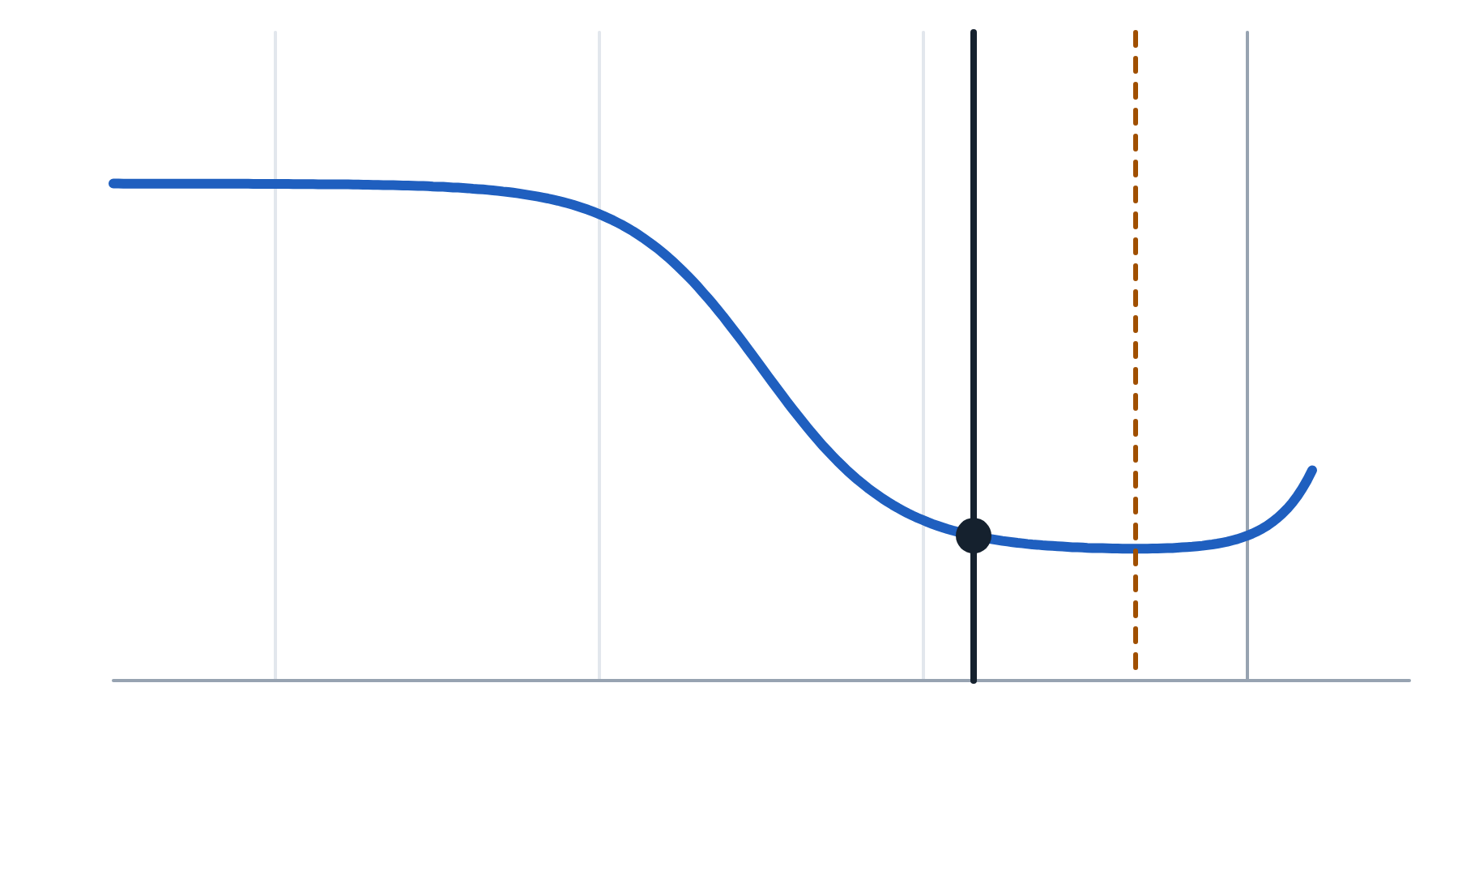
The learning-rate range test picks a rate about ten times below where the loss bottoms out.
§7 · GRADIENT DESCENT
The test. Train a few hundred steps while raising η exponentially, and plot loss against η.
pick ≈ 10× lower
loss bottoms out
The pick. About ten times below the minimum, in the steepest descent.
Defaults. SGD + momentum: η = 0.1 with BatchNorm. Adam: η = 3 × 10⁻⁴.
10⁻⁶
10⁻⁴
10⁻²
1
learning rate η, raised exponentially (log scale)
schematic curve
Lecture 2 · Learning: losses, backpropagation, gradient descent
25 / 31
Notes:
How do you actually pick a learning rate? The range test, from Leslie Smith. Train for a few hundred steps while increasing the learning rate exponentially, and plot loss against the rate on a log axis. The curve has a typical shape, shown schematically here: flat at tiny rates, a steep descent, a minimum, then an explosion. Do not pick the minimum; by then you are close to divergence. Pick roughly one order of magnitude below it, in the steepest part of the descent. If you skip the test, reasonable starting points are SGD with momentum at 0.1 for CNNs with batch normalization, and Adam at three times ten to the minus four for almost everything else. Both are starting points, not answers.

Slide 26
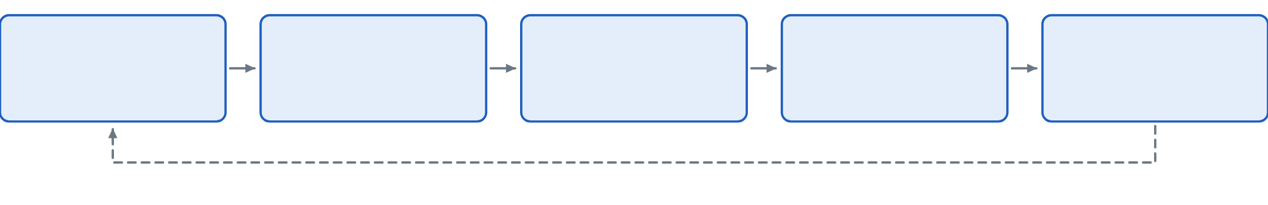
Every training step runs the same five operations in the same order.
§7 · GRADIENT DESCENT
1 · Clear gradients
2 · Forward pass
3 · Compute loss
4 · Backward pass
5 · Update weights
reset what was stored
predictions for the batch
compare with targets
fill every gradient
optimizer takes a step
repeat for every mini-batch, with the model in training mode
Not clearing gradients
Validating in training mode
Tracking gradients in validation
They accumulate across steps, so training degrades gradually.
Dropout stays on and BatchNorm uses batch statistics.
The graph is kept for a backward pass that never comes: memory rises sharply.
Lecture 2 · Learning: losses, backpropagation, gradient descent
26 / 31
Notes:
Every PyTorch training loop you will ever write has this skeleton. Put the model in training mode, then for every mini-batch: one, clear the stored gradients; two, the forward pass; three, compute the loss; four, the backward pass; five, the optimizer updates the weights. Those five, in that order, every time. Interviewers do ask you to write this from scratch. After each epoch, switch the model to evaluation mode and turn off gradient tracking for validation. The three classic errors. Forgetting to clear gradients: gradients accumulate, and training degrades progressively rather than failing outright, which makes it hard to spot. Forgetting evaluation mode: dropout stays active and batch norm keeps using batch statistics, so validation accuracy looks worse and fluctuates between runs on the same data. Forgetting to turn off gradient tracking during evaluation: everything still works, but memory use rises sharply and evaluation slows, because the graph is built for a backward pass that never comes.

Slide 27
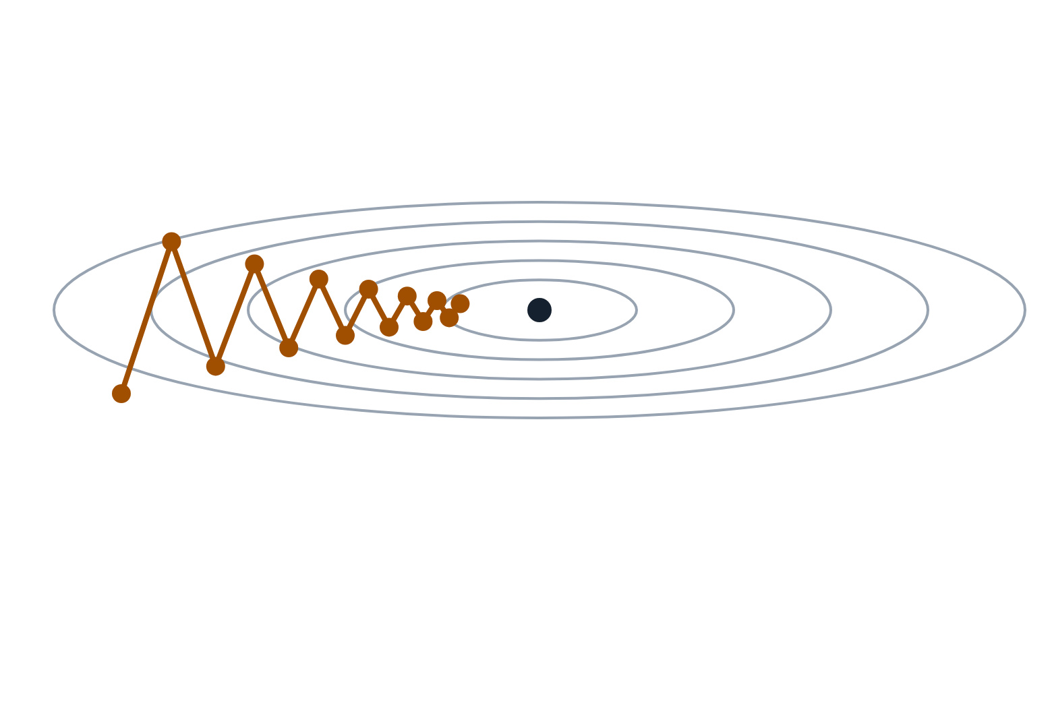
Saddles and ravines, not bad local minima, slow optimization in high dimensions.
§7 · GRADIENT DESCENT
Saddles dominate. If Hessian eigenvalue signs were independent, all d positive has probability ≈ 2⁻ᵈ.
Noise helps. Mini-batch noise knocks the optimizer off a saddle.
steep across the ravine: large λ
The real enemy. Ill-conditioning: eigenvalues spanning orders of magnitude make a ravine.
gentle along the floor: small λ
one scalar η must serve both
illustrative path of plain gradient descent
Lecture 2 · Learning: losses, backpropagation, gradient descent
27 / 31
Notes:
Students often imagine a bumpy two-dimensional surface and worry constantly about local minima. In high dimensions the reality is different and more encouraging. At a critical point, the Hessian's eigenvalues decide the type: all positive is a minimum, mixed is a saddle. If the signs were roughly independent, the chance that all d are positive is about two to the minus d. For a million dimensions that is indistinguishable from zero. Almost every critical point is a saddle, and mini-batch noise generally knocks the optimizer loose. Empirically, large networks from different seeds reach different parameters with very similar test loss. Flat minima tend to generalize better than sharp ones, which is part of why small batches and larger learning rates help; treat that as a heuristic. The real practical obstacle is the picture on the left: ill-conditioning. When eigenvalues span orders of magnitude the surface is a long narrow ravine. Gradient descent bounces across the steep walls while creeping along the floor, because one learning rate must serve both directions. That motivates the next three sections.

Slide 28

Larger batches need a scaled learning rate and warmup, and accumulation can simulate them.
§7 · GRADIENT DESCENT
Larger batch | Smaller batch
Less gradient noise | Noisier, sometimes generalizes better
Faster per epoch on a GPU | Slower per epoch
More memory | Less memory
Needs larger η and warmup | Tolerates a wide range of η
Linear scaling rule
Scale η with the batch size and add a few epochs of warmup. Reliable up to a few thousand.
loss / 4
loss / 4
loss / 4
loss / 4
one step
gradients add across the four passes
Lecture 2 · Learning: losses, backpropagation, gradient descent
28 / 31
Notes:
What changes when you change the batch size? Larger batches give less gradient noise, better GPU utilization and faster epochs, but use more memory, make fewer updates per epoch, and often need a larger learning rate with warmup. Smaller batches are noisier, sometimes generalize better, and tolerate a wide range of learning rates. The practical rule when you scale the batch is the linear scaling rule: multiply the learning rate by the same factor, and add a few epochs of linear warmup. It works up to a few thousand and then breaks down; some people prefer square-root scaling for adaptive optimizers. Treat both as heuristics to validate. If you are memory-limited, gradient accumulation gives a large effective batch on small hardware: run several forward and backward passes, letting gradients add up, then take one step. Divide each loss by the number of accumulation steps, or you are summing four batch means instead of averaging them, which effectively quadruples the learning rate. One subtlety: batch norm still computes statistics per actual pass, so it is not perfectly equivalent.

Slide 29
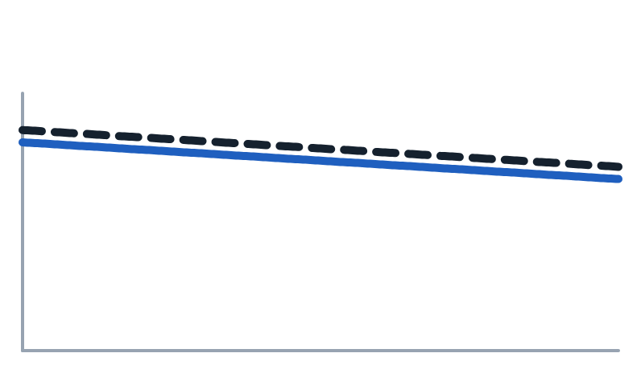
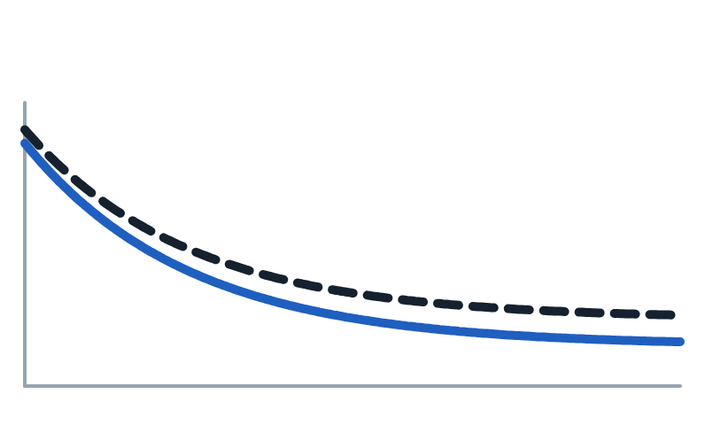
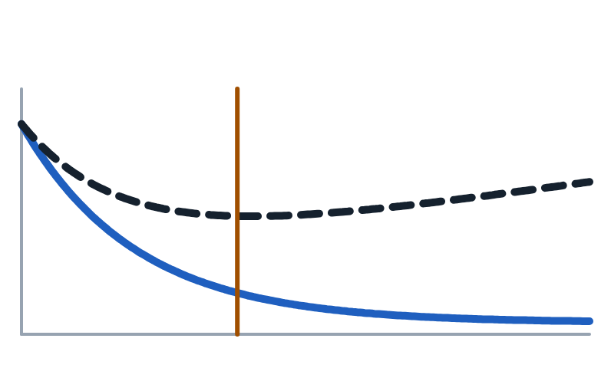
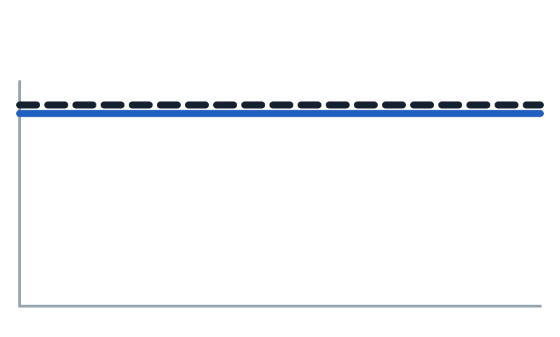
Reading training and validation loss together tells you the regime and when to stop.
§7 · GRADIENT DESCENT
━ training loss ╍ validation loss │ best epoch schematic curves
Underfitting
Healthy
Overfitting
Broken
Bigger model, longer, higher η.
Keep going.
Regularize, or stop early.
Flat from step one: a bug.
Early stopping: keep the parameters from the best validation epoch, not the last one.
Lecture 2 · Learning: losses, backpropagation, gradient descent
29 / 31
Notes:
Watch training loss and validation loss together; there are four regimes. Both high: underfitting, so use a bigger model, train longer, or raise the learning rate. Both falling: healthy, keep going. Training falling while validation rises: overfitting, so regularize, get more data, or stop early. Both flat from the very start: something is broken, and a later section of the tutorial gives a debugging checklist. Early stopping means keeping the parameters from the epoch with the best validation loss, the vertical line in the overfitting panel, rather than the last epoch. It costs nothing and is close to free regularization. Always save the best checkpoint, not the final one.

Slide 30
Each section of today’s lecture reduces to one sentence worth remembering.
RECAP
§5
Losses are negative log-likelihoods. Use cross-entropy on raw logits for classification.
§6
Backprop is the chain rule run backward: four equations, all gradients for ≈ one extra pass.
§7
Step against the gradient, keep η below 2/λₘₐₓ, and read train and validation curves together.
Lecture 2 · Learning: losses, backpropagation, gradient descent
30 / 31
Notes:
Lecture 2 in three sentences. Section 5: losses are negative log-likelihoods, squared error for Gaussian noise and cross-entropy for classes, and classification losses take raw logits. Section 6: backpropagation is the chain rule run backward through the graph; four equations give every gradient for roughly the cost of one extra pass. Section 7: step against the gradient, keep the learning rate below two over the largest curvature, and read training and validation curves together. Next lecture: why depth helps, and the engineering that makes deep networks train and generalize: initialization, optimizers, normalization and regularization.

Slide 31
These are the primary sources behind today’s claims, for further reading.
REFERENCES
Huber, P. (1964). Robust estimation of a location parameter. Annals of Mathematical Statistics.
Smith, L. (2017). Cyclical learning rates for training neural networks (range test). WACV.
Rumelhart, D., Hinton, G. & Williams, R. (1986). Learning representations by back-propagating errors. Nature.
Goyal, P. et al. (2017). Accurate, large minibatch SGD: training ImageNet in 1 hour.
Baydin, A. et al. (2018). Automatic differentiation in machine learning: a survey. JMLR.
Dauphin, Y. et al. (2014). Identifying and attacking the saddle point problem in high-dimensional non-convex optimization.
Chen, T. et al. (2016). Training deep nets with sublinear memory cost (gradient checkpointing).
Keskar, N. et al. (2017). On large-batch training for deep learning: generalization gap and sharp minima. ICLR.
Szegedy, C. et al. (2016). Rethinking the Inception architecture (label smoothing). CVPR.
Dinh, L. et al. (2017). Sharp minima can generalize for deep nets. ICML.
Lecture 2 · Learning: losses, backpropagation, gradient descent
31 / 31
Notes:
The primary sources for today. Two worth special mention: Dauphin and colleagues for the saddle-point picture of high-dimensional optimization, and Dinh and colleagues, who show that flatness is not reparameterization-invariant, which is why the flat-minima story is a heuristic rather than a theorem.

